Slide 1

Welcomes
DAY 5
Boot camp

Slide 2
DAY 5 AGENDA
Topic | Topic Description | Estimated Time
Snippet development | Snippets and Runbook applications | 9am – 10:15
BREAK |  | 10:15 – 10:30
API | APIs and Functions for snippet development | 10:30 – 11: 00
Snippet Development | Best practice | 11:00 – 12:00
LUNCH |  | 12:00 – 1:00
Platform | Appliances Collector Groups (CUG’s) and CUG Balancing Collector Task Manager Config Push Data Pull Daily maintenance Backups Behavior Normalization Web Configuration Utility/ PHPmyAdmin | 1:00 – 3:00 Break between

Slide 3

What’s a Snippet?
Snippets are user-defined Python scripts that will be executed by the platform instead of a standard platform function.
Snippets can be used in Dynamic Applications to run in place of the built-in collection types (SNMP, Database, etc).
Snippets can be used in Run Book actions to run in place of the built-in action types (Send an Email, Open a Ticket, etc).

Slide 4
Performance & Config Snippet Dynamic Applications

Slide 5
Snippet Dynamic Applications
Snippet Dynamic Applications have an additional tab for adding and editing python code.
Snippet Collection Objects have two snippet-specific fields, but most settings are common to all Dynamic Application types.
Presentations, Thresholds, and Alerts in Snippet Dynamic Applications are the same as all other Dynamic Applications.

Slide 6
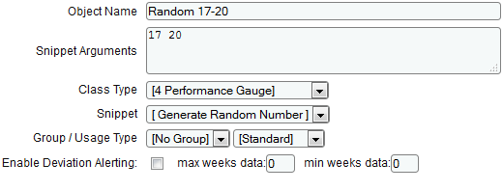
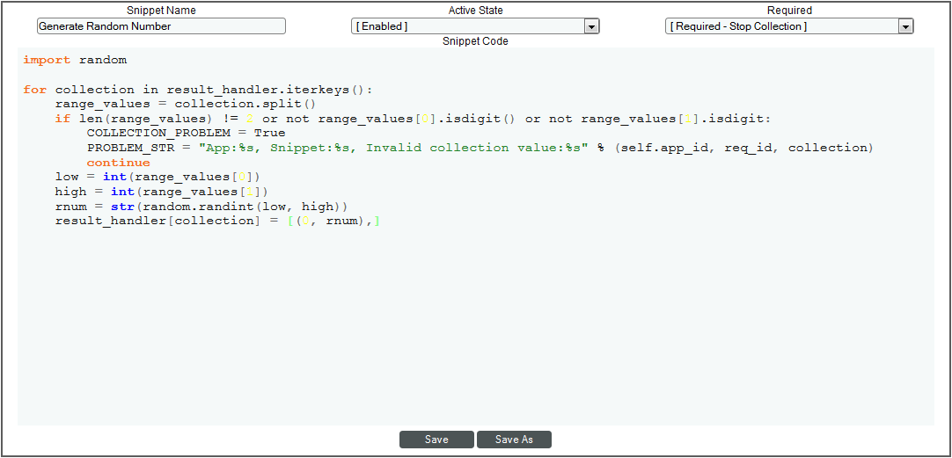
Snippet Collection Objects
Snippets are related to the collection objects in a Dynamic Application
Each collection object specifies:
The Snippet that will perform collection
Arguments that indicate how the object should be collected
Notes:
The screenshots show how the two fields that are specific to Snippet apps – Snippet arguments and Snippet – relate to the snippet editor. This is a basic example, where the “collection” is generating a random number for each collection object.
The “Snippet” field maps the collection object to the specific snippet. The field will show the names of each snippet in the Dynamic Application. Often, Dynamic Applications include only one snippet.
The value in the “Snippet Arguments” field is passed to the snippet. In this case, the arguments are the range of values in which the random number must fall. The arguments are the method for telling a snippet how to collect a value for a specific collection object. As the developer, you can chose what the arguments are to simplify your snippet code. For example, in a snippet that does SNMP collection, the arguments might be the SNMP OID, which can be easily passed to an SNMP collection function.

Slide 7

Processing Collection Objects
Snippet code is passed to a dictionary called result_handler
The result_handler dictionary contains one entry for each collection object that is linked to the snippet.
The keys in result_handler are the Snippet Arguments for the collection objects.
The values in result_handler are dictionaries that contain all the attributes of the collection objects.
Notes:
This is different from the older versions Cisco uses.

Slide 8
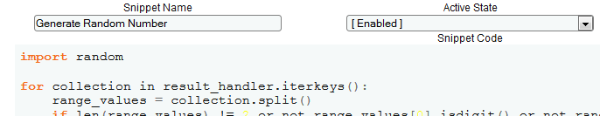
Processing Collection Objects – Example
The snippet code iterates over the keys in result_handler, which are the Snippet Arguments for each collection.
The snippet arguments can then be used to collect a value for each collection object.
Notes:
Back on the Random Number Example.
This snippet does not require any of the other information about the collection objects other than the arguments, so just uses the keys in result_handler

Slide 9
Reporting Values for Collection Objects
The result_handler dictionary is used to pass collected values back to the platform.
The collected value(s) for a single collection object must be formatted as a list, even if it includes only one collected value.
Remember, multiple values for a single collection object are displayed as multiple trend lines on a graph or multiple rows in a table.
Each list value must be a tuple that includes an index value and the collected value for that index.
The simplest method for returning results is to assign the list value directly to the result_handler dictionary key for that collection object. However, you must pass the whole list a single time using this method.
Notes:
This is different from the older versions Cisco uses.

Slide 10
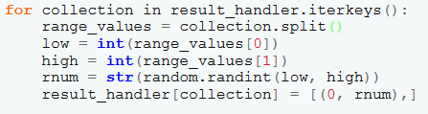
Returning Results - Example
Each iteration, a key in result_hander is assigned to the variable “collection”
The Snippet Arguments are processed to get the min and max values for a random number
The list of results is assigned directly to the key in result_handler for this collection object
The “collected” random number is formatted in a list of one item. The index is hard-coded to zero

Slide 11
Assigning Index Values
Each collected value must be assigned an index by the snippet code.
The indexes must:
Be unique within the list of values for a collection object
Stay consistent across poll periods
Match the indexes assigned to related collection objects
Common examples:
The unique identifiers assigned by the external systems, e.g. SNMP table indexes.
The name/label for each table row/trendline, e.g. file system partition labels.
For objects that only ever have one value, use zero.

Slide 12
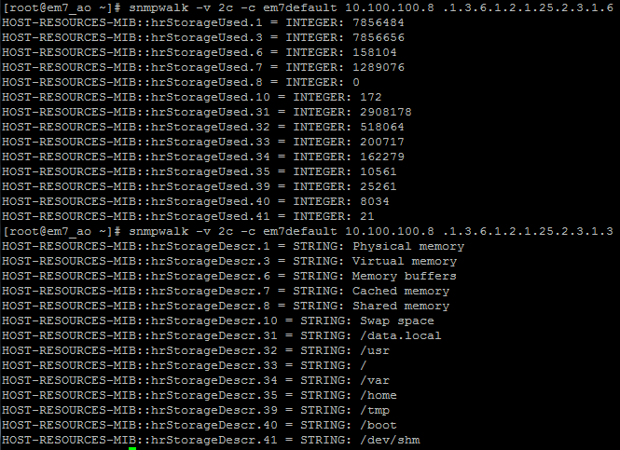
Assigning Index Values - Example
Suppose a snippet collects the values from two SNMP OIDs, the space used and name of file systems.
The list of collections could be assigned the SNMP indexes as the index values.
However, if the SNMP indexes have the potential to change between polls, the label values could be used instead.

Slide 13
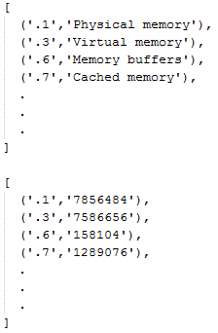
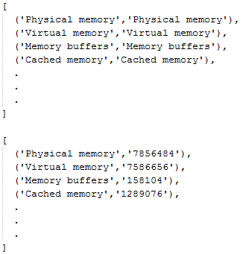
Formatting Collection Object Lists - Example
The lists to the left show the two collections indexed by SNMP index. The lists to the right show the two collections indexed by the file system name:
Notes:
These are the lists of formatted values that would be passed back to result_handler. The dots here indicate a continuation of list values (you get the idea!).

Slide 14
Reporting Collection State
Snippet code is responsible for reporting the overall status of its collection back to the platform. By default, a successful collection is assumed.
To report a failed collection, e.g. a request timed out, and tell the platform to discard the collection results, populate the following variables:
COLLECTION_PROBLEM: Set this variable to True to report a failed collection.
PROBLEM_STR: Set this variable to a descriptive string. If COLLECTION_PROBLEM is True, the platform automatically generates a failed collection event. This string is included in the event message.

Slide 15
Debug Logging
Snippet Dynamic Applications have access to the standard debug logging functions used by ScienceLogic processes through the self.logger handle.
Two levels of log messages are available:
Debug: Log entry will be written to the /data/logs/silo.log file if debug logging is enabled for the Dynamic Application collection process.
Ui_debug: Log entry will appear in the user interface debug logging output, where a test collection is manually initiated by the user. These log messages are truncated to 255 characters. If debug logging is enabled, the log entries are also written to the /data/logs/silo.log file.
Snippet Dynamic Applications have access to the standard debug logging functions used by ScienceLogic processes.
To write debug messages, use one of the following functions:
Self.logger.debug(log_message)
Self.logger.ui_debug(log_message)

Slide 16
Snippet Variables
Variables are made available to snippet code that include information about the device for which collection is being performed.
For regular (non-component) devices this_device is a named tuple that includes the following values:
this_device.name:
This_device.name
This_device.ip
This_device.snmp_cred_id
The self.cred_details dictionary contains values from the aligned credential. The keys in this dictionary are different for each credential type and correspond to each field.
Additional variables are available for component devices, including unique identifiers, parent device information, and root device information.

Slide 17
The em7_snippets Module
The em7_snippets module is automatically included for your snippet code. This module includes:
ScienceLogic’s standard functions for performing SNMP, Database, WMI, WBEM, and HTTP requests.
Functions for polling Nagios agents.
A function for generating alerts via the ScienceLogic API.
Functions for caching data between snippets and/or poll periods.

Slide 18
Snippet Run Book Actions

Slide 19
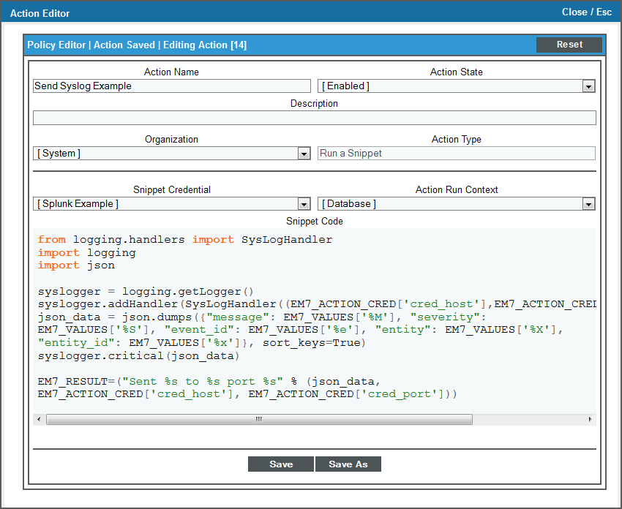
Defining a Run Book Snippet
Run Book Snippets share common fields with other action types
A credential can be aligned to a run book snippet
Snippets can be configured to run on the Database or the Data Collector

Slide 20
Using Credential Information
Run Book Snippets have access to multiple credentials:
EM7_ACTION_CRED is a dictionary of values for the credential aligned with the Run Book Action.
EM7_DEVICE_CRED is a dictionary of values for the SNMP Read Credential aligned with the device associated with the triggering event (if applicable).
EM7_DYNAMIC_APP_CREDS is a dictionary of dictionaries for the Dynamic Application credentials for the device associated with the triggering event (if applicable). The dictionary is keyed by Dynamic Application ID.
The structure of the credential dictionaries is the same as for Snippet Dynamic Applications.

Slide 21
Using the Results of Previous Actions
Two variables are available that include the results of the previous actions executed by the same Automation Policy:
EM7_LAST_RESULT contains the result of the action that executed immediately before the snippet.
EM7_LAST_RESULT_LIST contains detailed information about all the actions that were executed before the snippet.

Slide 22
EM7_LAST_RESULT_LIST
EM7_LAST_RESULT_LIST is a list object. List index 0 is the first action executed by the automation policy, list index 1 is the second, etc.
Each entry is a dictionary with the following entries:
Success. A Boolean value indicating whether the action executed successfully.
Type. An integer that represents the type of action that was executed.
Result. The result of the action. Typically a dictionary.
Metrics. For snippet actions only, returns execution information including start time, end time, and resource usage.
Message. For actions that failed, returns an error message.
For example, to get the result of the second action executed by the automation policy, you would use:
EM7_LAST_RESULT_LIST[1].result
Notes:
For specific type values, refer to the documentation.

Slide 23
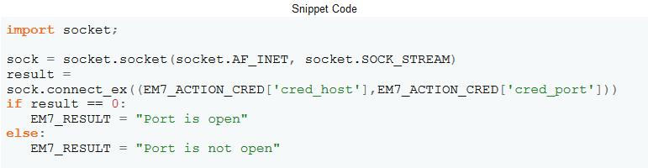
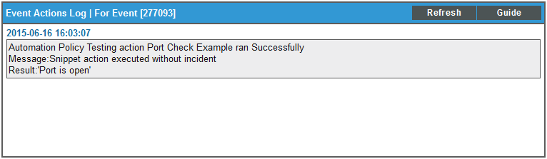
Outputting a Result
To report a result, assign a value to the EM7_RESULT variable:
In addition to appearing in the logs, the result can also be used in subsequent actions, including non-snippet actions.

Slide 24
Variables
The same list of variables available in other action types, entity name, event message, etc, are available to snippet code.
Variables are in the EM7_VALUES dictionary.
The keys in EM7_VALUES are the variable substitution characters used in other types of actions.
For example, to use the IP address of the device on which the event was triggered:
EM7_VALUES[‘%a’]

Slide 25
Debug Logging
Unlike Dynamic Application snippets, Run Book Snippets are not given access to log to the silo.log file.
A function is available, em7_snippets.logger, to create your own debug log file:
logger = em7_snippets.logger(filename=‘/data/logs/mylogfilename’)
To write log messages to the log file:
logger.debug(“Log Message”)
Do not leave debug logging in production code as it could fill up a partition. Instead, put all necessary output in the EM7_RESULT variable.

Slide 26
Best Practices for Snippet Code

Slide 27
Excluded Modules
The following modules are blocked from being imported in to snippet code to prevent interference with ScienceLogic processes:
os
os.path
pickle
shelve
platform
thread
threading
dummy_thread
dummy_threading
posix
pwd
spwd
grp
termios
pipes
posixfile
resource
commands
subprocess
signal
popen2
imp

Slide 28
Understanding How Your Snippet is Executed
The ScienceLogic platform executes snippets as part of a larger process:
For Dynamic Applications, your snippet will occupy one collection thread until it completes. Typically there are 2 – 16 collection threads based on the CPU count. If multiple devices are subscribers of your Dynamic Application, it’s possible for all collection threads to be occupied by your snippet code at once.
For Run Book Automation, the chain of actions configured for an automation policy will stop until your snippet completes. Your snippet will be timed out after 60 seconds.
Never, ever, call sys.exit. You will close the parent process.

Slide 29

Why Are You Waiting?
ScienceLogic doesn’t recommend using waiting in snippet code. If you’re considering waiting:
In Run Book, consider using the repeat option in an Automation Policy to run your snippet multiple times or use multiple actions with different execution times.
For Performance and Configuration Dynamic Applications, you are collecting data associated with a single timestamp. If you’re waiting, you might want to consider another collection method – e.g. Journal Dynamic Applications or asynchronous eventing via the API, Syslog, Traps, or Email.

Slide 30
Using Python Packages
There are multiple packages installed by default that can be used to perform common tasks, for example:
Paramiko for SSH connections
Pycurl and suds for HTTP/SOAP collection
If you’re looking for particular functionality:
Use an em7_snippets function, if available.
If there’s no em7_snippet function, import a python package that is installed by default.
If there is no function or package available that does what you want, ScienceLogic will typically work with you to add an additional Python package to the standard build if appropriate.

Slide 31


Resources And Questions
For more information:
Dynamic Application Development manual
Dynamic Application Development – Snippets manual
Run Book Automation manual
All manuals are available on the Customer Portal:
http://portal.sciencelogic.com
Add/Remove Devices

Slide 32
EM7 Platform

Slide 33

Objectives
Appliances
Collector Groups (CUG’s) and CUG Balancing
Collector Task Manager
Config Push
Data Pull
Daily maintenance
Backups
Behavior
Normalization
Web Configuration Utility
Capacity Management
Access Methods
Platform

Slide 34
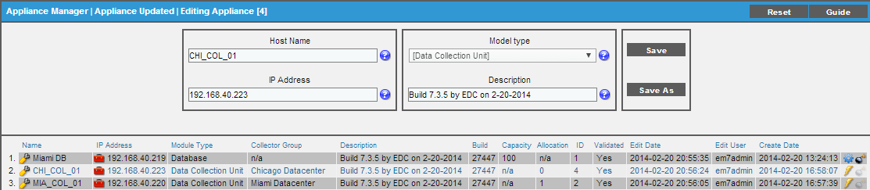
Appliances
System > Settings > Appliances
Lists all EM7 appliances:
Icons:
Gear - icon opens PHPMyAdmin tool,
Toolbox - icon opens Web Configuration Utility
Lightning - initiates Config Push
Provides Module Type and ID, system capacity and devices per collector (allocation)
Validated = licensed
Administration Portal, Databases, and Integration Server are added to this page automatically
In order to add a Data or Message Collector:
Add collector on this page manually
License with the Web Configuration Utility
Add to a Collector Group on System > Settings > Collector Groups
Platform
Notes:
ScienceLogic automatically creates a default organization, called System. This organization has the ID number “0” (zero). The System organization has some behavior that differs from user-defined organizations.
If you do not specify an organization when creating a user account, the new account is assigned to the System organization.
If you do not specify an organization when performing dynamic-discovery, all devices (and their components), interfaces, and IP networks are assigned to the System organization.
You cannot delete the system organization.
You cannot bulk-edit the system organization.

Slide 35
Collector Groups
A Collector Group is a group of EM7 Data Collectors.
Grouping multiple Data Collectors allows you to:
Create a load-balanced collection system. At any given time, the Data Collector with the lightest load will manage the next discovered device. This is the default behavior. All Data Collectors in the group must be able to access the managed devices.
Optionally, create a redundant, high-availability system that minimizes downtime should a failure occur. If a Data Collector fails, one of more Data Collectors servers in the Collector Group will handle collection until the problem is solved.
Important Notes:
If the entire Collection Group is not available for whatever reason, the collection will continue, but the collected data will not be considered correct and therefore it will be discarded.
A single Collector Group cannot include multiple devices that use the same Admin Primary IP Address (the address that EM7 uses to communicate with a device). Put over-lapping IP addresses on different Collector Groups.
The collectors in a Collector Group are not in a cluster, there is no VIP or heartbeat network between them. The Database server determines the status of the collectors and re-distributes the devices if needed.
When building a multi-collector CUG, it must have a Message Collector for inbound messages.
Platform
Notes:
Body Slide Option 2

Slide 36
Collector Group Open Ports
By default Data Collectors accept connections on the following ports (all others closed).
The firewall service is located at /etc/init.d/em7_firewall
To verify that the database can reach the collector: from the database server nmap –p 7707 ip_of_collector
Port | Use
TCP 22 | Secure SHell (SSH)
TCP 53 | Domain Name Services (DNS)
TCP 123 | Network Time Protocol (NTP)
UDP 161 | SNMP requests
UDP 162 | Inbound SNMP Trap messages
UDP 514 | Inbound Syslog messages
TCP 7700 | Web Configuration Utility
TCP 7707 | Data Pull
Platform

Slide 37
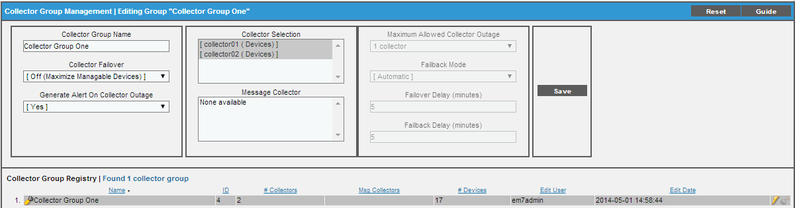
Create a Collector Group
System > Settings > Collector Groups
Collector Groups:
All-In-One:
All-In-One system have the Collector Group built automatically
Will allow Virtual Collector Group
Distributed system
A Collector Group must be created in order for collection to begin
If it is a multiple collector Collector Group and message collection is required, then a Message Collector should be aligned
Platform
Notes:
ScienceLogic automatically creates a default organization, called System. This organization has the ID number “0” (zero). The System organization has some behavior that differs from user-defined organizations.
If you do not specify an organization when creating a user account, the new account is assigned to the System organization.
If you do not specify an organization when performing dynamic-discovery, all devices (and their components), interfaces, and IP networks are assigned to the System organization.
You cannot delete the system organization.
You cannot bulk-edit the system organization.

Slide 38
Collector Group Redundancy
System > Settings > Collector Groups
Collector Failover Off (Maximize Manageable Devices)
New devices will be assigned (via re-balancing) to Data Collector with the lowest load
There is no Data Collector redundancy in this configuration
Collector Failover On (Maximize Reliability)
New devices will be assigned (via re-balancing) to Data Collector with the lowest load
Devices are re-balanced to other Data Collectors if a Data Collector fails
Recommended: set Generate Alert on Collector Outage to “Yes”
Platform

Slide 39
Collector Group Load Balancing
Collector Groups with more than one Data Collector distribute devices based on load:
Initial discovery is done by the assigned Data Collector (Discovery Session Editor)
Once discovered, the device is assigned to the Data Collector with the lowest load.
Load is determined by the amount of time that Dynamic Application collection takes.
Every device has collection meta data tables including time-to-collect values (meta_stats.dev_stats_rollup_hourly)
EM7 re-balances a Collector Group when:
A Collector Group is created
A new Data Collector is added to an existing Collector Group
Failover or failback occurs within a Collector Group
A user clicks the lightning bolt icon for a Collector Group (System > Settings > Collector Groups)
Before Re-balance
After Re-balance
Collector Group
Collector Group
122s spent on collection
61s spent on collection
90s spent on collection
93s spent on collection
COL1
COL2
COL1
COL2
Platform
Notes:
ScienceLogic automatically creates a default organization, called System. This organization has the ID number “0” (zero). The System organization has some behavior that differs from user-defined organizations.
If you do not specify an organization when creating a user account, the new account is assigned to the System organization.
If you do not specify an organization when performing dynamic-discovery, all devices (and their components), interfaces, and IP networks are assigned to the System organization.
You cannot delete the system organization.
You cannot bulk-edit the system organization.

Slide 40
Collector Task Manager
Validating collector licenses and marking collector availability states appropriately
Checking the time synchronization between the database and the collectors (alerting if necessary)
Rebalancing, if necessary
Pushing out asynchronous tasks to a collector
Asynchronous tasks are
Discovery
Any lightning bolt initiated tasks
Toolbox commands
Push is to sync master_logs.spool_process on DB to the same table on the collector
For example, before pushing a discovery session to a collector, task manager executes appropriate REPLACE INTO queries on the collector to tables:
master.system_credentials_X tables
master.policies_discovery_X tables
NOTE: There is some overlap between config_push and task manager in this regard in that they insert in to some of the same tables, although the list of tables collector task manager can write to is not stored in the database, it’s all in code.
Platform

Slide 41
Use Case
The Challenge:
You have a customer that is turning down some of their servers after having replaced them with upgraded ones. These systems are now turned off and un-racked, but you do need to be able to run reports on the data from the systems at the end of the quarter. Deleting the devices from EM7 will delete the data, but keeping the devices isn’t the right solution either.
The Solution:
Create a Virtual Collector Group (VCUG) in the EM7 system (System > Settings > Collector Groups)
Move the devices to the VCUG
The Result:
The devices will continue to be viewable in EM7 for data reporting purposes, but EM7 will not monitor the devices, no events will be generated, and the devices will not count against the system capacity license.
Platform

Slide 42
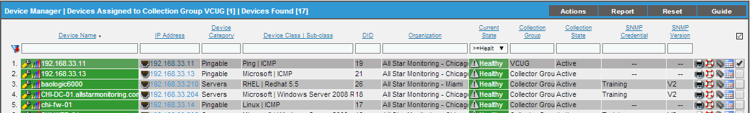
Virtual Collector Unit Group- VCUG
A Virtual Collector Group is a Collector Group that will serve as a storage area for the data associated with any devices assigned to it. A Virtual Collector Group does not have any Data Collectors or Message Collectors in it.
Devices in a VCUG:
Are not aligned to an actual collector, so no collection is done
Will not count against the licensed capacity
Will have all historical data and users can run reports, view graphs, select them on Dashboards, etc…
Traps and Syslog messages will not be processed for the device
This device will not be collected
Platform
Notes:
ScienceLogic automatically creates a default organization, called System. This organization has the ID number “0” (zero). The System organization has some behavior that differs from user-defined organizations.
If you do not specify an organization when creating a user account, the new account is assigned to the System organization.
If you do not specify an organization when performing dynamic-discovery, all devices (and their components), interfaces, and IP networks are assigned to the System organization.
You cannot delete the system organization.
You cannot bulk-edit the system organization.

Slide 43
Config Push
config_push.py – frequency 60 seconds
Updates each Data Collector to make sure that local information on each Data Collector is consistent with the policies on the Database system.
System > Settings > Appliances lightning bolt icon: manual Config Push
This query shows all tables that are managed by Config Push:
select * from master.definitions_collector_config_tables
Only the tables that have changed are updated
Transaction is verified with a checksum comparison between the table in the DB and the Data Collector/Message Collector
Database Server
Collector Group
config_push.py
COL1
60 seconds
config_push.py
COL2
Platform
Notes:
ScienceLogic automatically creates a default organization, called System. This organization has the ID number “0” (zero). The System organization has some behavior that differs from user-defined organizations.
If you do not specify an organization when creating a user account, the new account is assigned to the System organization.
If you do not specify an organization when performing dynamic-discovery, all devices (and their components), interfaces, and IP networks are assigned to the System organization.
You cannot delete the system organization.
You cannot bulk-edit the system organization.

Slide 44
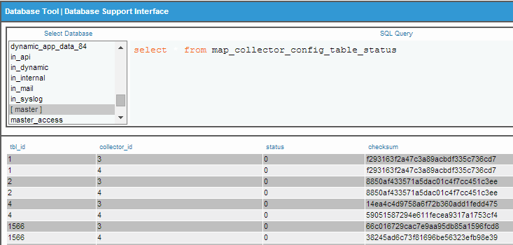
Config Push: Detail
Config push starts, examines current status in
master.map_collector_config_table_status – tracks the state of the tables on each collector via last modified date/time
Whenever a policy update is made there is a DB trigger to a stored procedure to update the mapping in this table
The table has a row per collector per table.
If pushing the credentials table to all collectors, the mysql dump of the tables to disk is serial and the push to the collectors is parallel. It does not have to wait for all tables to be dumped.
Platform

Slide 45
Data Pull
The data pull process is responsible for pulling collected data from Data Collectors and Message Collectors back to the primary Database Server.
The data being pulled back is stored in a data structure called a Storage Object. The different pull processes pull Storage Objects at different frequencies and are responsible for different data types (the more important the data is, the faster it gets pulled):
Name | Process | Responsible for: | Frequency
High Frequency | em7_hfpulld.py | Events Discovery Logs Toolbox Logs Any manual policy run via | Always
Medium Frequency | em7_mfpulld.py | All performance and configuration data that is not High or Low frequency | Always
Low Frequency | em7_lfpulld.py | Log message data that does not match an event policy Content Verification page results | Always
Platform
Notes:
ScienceLogic automatically creates a default organization, called System. This organization has the ID number “0” (zero). The System organization has some behavior that differs from user-defined organizations.
If you do not specify an organization when creating a user account, the new account is assigned to the System organization.
If you do not specify an organization when performing dynamic-discovery, all devices (and their components), interfaces, and IP networks are assigned to the System organization.
You cannot delete the system organization.
You cannot bulk-edit the system organization.

Slide 46
Data Pull Architecture
All Data Pull processes have frequency of “Always”
Collector Group 1
COL1
Data Pull Request TCP 7707
Storage Objects Response
Database Server
Data Pull Request TCP 7707
COL2
Storage Objects Response
Data Pull Request TCP 7707
Collector Group 2
Storage Objects Response
COL3
By default Data Pull gets 1000 storage
objects during each iteration. This number
can be tuned by adding this line in silo.conf
BLOCK SIZE = 1000
This should not be changed without guidance
from ScienceLogic Support.
Platform

Slide 47
Maintenance processes: Daily
Frequency | Appliance | Task
Daily | Data Collector | Prune expired Collector Unit Data Buffer data
 | Data Collector | Purge old temporary tables
 | Database | Certificate expiration events
 | Database | Report data maintenance
 | Database | Dynamic app table maintenance
 | Database | Prune expired data
 | Database | Audit overlapping device IP addresses
 | Database | Dynamic Application Journals drop unmapped presentation columns
 | Database | Unclassified IP’s
 | Database | Local cleanup
 | Database | Device identities maintenance
 | Admin Portal | Local cleanup
Platform
Notes:
ScienceLogic automatically creates a default organization, called System. This organization has the ID number “0” (zero). The System organization has some behavior that differs from user-defined organizations.
If you do not specify an organization when creating a user account, the new account is assigned to the System organization.
If you do not specify an organization when performing dynamic-discovery, all devices (and their components), interfaces, and IP networks are assigned to the System organization.
You cannot delete the system organization.
You cannot bulk-edit the system organization.

Slide 48
Maintenance processes: Hourly
Frequency | Appliance | Task
Hourly | Data Collector | Dynamic App Collector State Maintenance
 | Database | IP cleanup – remove old tmp files, backup files, change incorrect owner, group, and perms
 | Database | Dynamic App Object
 | Database | Dynamic App Integrity Maintenance
 | Database | Event Policy Maintenance
 | Database | Device State
 | Database | Purge Vanished Devices
 | Database | Component Relationship Maintenance
Platform

Slide 49
Maintenance processes: Frequent
Frequency | Appliance | Task
Frequent | Database | Ticket Escalations
 | Database | Device Maintenance
 | Database | Service Maintenance
 | Database | Scheduled Reports
 | Database | Scheduled Tickets
 | Database | User Scheduled (Device Maintenance)
 | Database | Scheduled Patches
 | Database | Discovery Maintenance
 | Database | Scheduled Discoveries
 | Database | Scheduled Backups
Platform

Slide 50
Backups
2 types of backup in EM7:
Configuration: utilizes mysqldump of configuration databases, no performance data. This dump can be used to rebuild the system, meaning all of the devices, policies, tickets, users, orgs, etc… There will be no collected data though.
Full: compresses the entire database into a file and transfers that to a remote file system. This method can recover the entire system from the point of the last backup.
Configuration Backup
Full Backup
Configuration tables
EM7 Database
Database directory
EM7 Database
Text File
Tar File
mysqldump
tar
Line of demarcation. EM7 no longer controls the file beyond this point
File transfer
File transfer
Remote File System
Remote File System

Slide 51
Backup Process and Events
Backup order of operations
Maintenance Frequent starts the process
Backups utilize a Basic/Snippet credential with the target file server details in it (hostname/IP, port, timeout, username, password)
EM7 first places a 0 KB test file on the target server. If this fails the backup process exits with an Event in the System Log
With the test file placed and then deleted, the system runs the mysqldump (config backup) or the tar (full backup). This file is then transferred to the file server.
Upon completion the backup successful event is put into the system log (severity: notice)

Slide 52
Normalization
The aggregation/roll up of multiple data points collected over a standard time period in to a single row of data. The standard time periods are:
15 minutes
20 minutes
30 minutes
60 minutes
1 day
Each normalized data row includes:
The timestamp at the end of the standard time period.
The number of data points used to calculate the other values in the row.
The ideal (maximum) number of data points that could be included in the time period.
The average, maximum, minimum, sum, and standard deviation for the data points.
Collected objects from a Dynamic Applications that have had their Presentation Object disabled are NOT normalized!
Platform

Slide 53
Roll Up Flow for All Raw Data Poll Frequencies
The following collection frequencies are normalized:
1
3
2
5
10
15
30
60
120
360
720
1440
15
20
30
Hourly
Daily
Platform

Slide 54
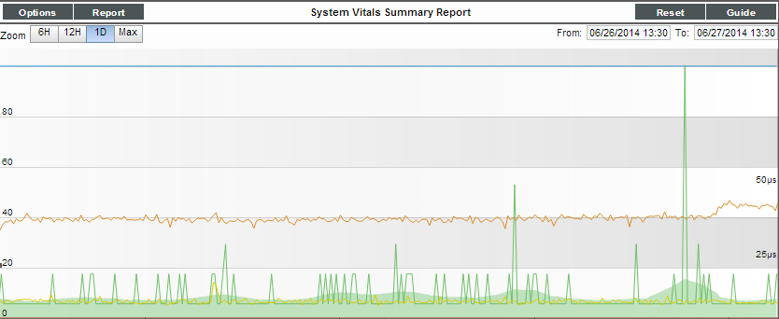
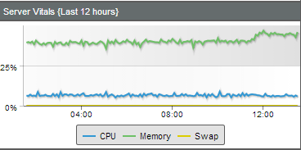
Normalized Data
Normalized data is used for:
Quick Reports
Performance graphs (Device Reports Panel > Performance)
As an Option (hourly and daily normalized data)
Dashboards
Can use Raw data or any Normalized data based on the time span selected
Platform

Slide 55
EM7 Performance Power Pack
The Support Performance Power Pack 17 Dynamic Applications that can be used to track key EM7 platform performance metrics:
Note: This Power Pack is only installed during deployment and requires the installation of an addition python script to collect all of the various data points.
Build Check – Alerts if build numbers are inconsistent
Config Push – tracks Config push operation time
Config Parser (my.cnf) – parses /etc/my.cnf (MySQL configuration file) so that it can be reviewed in the UI
Config Parser (silo.conf) – parses /etc/silo.conf (EM7 configuration file) so that it can be reviewed in the UI
Database Sizes – gets database sizes from information_schema tables in MySQL
Datapull Configuration – gathers Config settings for datapull
Datapull Stats – gathers statistics on datapull performance
DRDP Proxy Stats – monitors memory and act_log usage
File System – display EM7 file system usage as a Config app
Platform
Notes:
ScienceLogic automatically creates a default organization, called System. This organization has the ID number “0” (zero). The System organization has some behavior that differs from user-defined organizations.
If you do not specify an organization when creating a user account, the new account is assigned to the System organization.
If you do not specify an organization when performing dynamic-discovery, all devices (and their components), interfaces, and IP networks are assigned to the System organization.
You cannot delete the system organization.
You cannot bulk-edit the system organization.

Slide 56
EM7 Performance Power Pack (cont.)
The Support Performance Power Pack 17 Dynamic Applications that can be used to track key EM7 platform performance metrics:
InnoDB Size – tracks actual size of InnoDB and compares to the MAX configuration in my.cnf
Maintenance Tracking – tracks time for Daily Maint in aggregate and by each pruner script
(continued next slide)
MySQL Performance – tracks certain stats such as the number of selects, inserts, deletes, connected threads…
Normalization Tracking – tracks aggregate and individual times for the normalizers
Platform Statistics – gathers an inventory of number of devices, interfaces, etc…
PT – Disk Stats – gathers information on local disk stats
Rows Behind – collects how far behind datapull is in getting storage object from a collector
ScienceLogic Configuration – gets statistical information from the OS on the local appliance
Platform
Notes:
ScienceLogic automatically creates a default organization, called System. This organization has the ID number “0” (zero). The System organization has some behavior that differs from user-defined organizations.
If you do not specify an organization when creating a user account, the new account is assigned to the System organization.
If you do not specify an organization when performing dynamic-discovery, all devices (and their components), interfaces, and IP networks are assigned to the System organization.
You cannot delete the system organization.
You cannot bulk-edit the system organization.

Slide 57
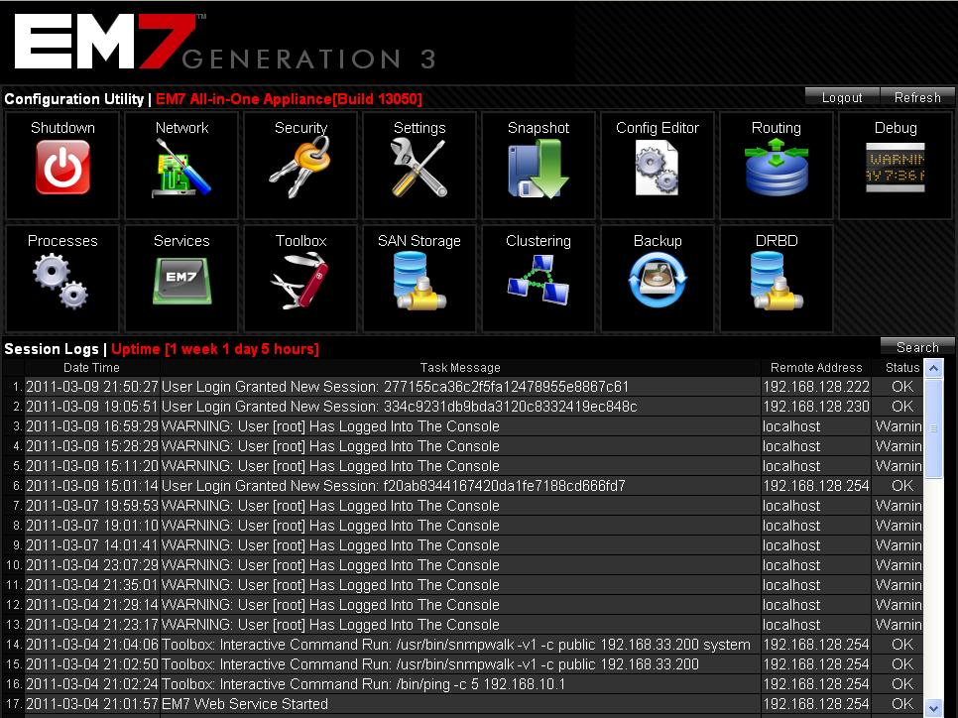
Web Configuration Utility
https://ip-address-of-appliance:7700
The Web Configuration Utility allows you to configure system-level settings for your appliance(s)
Each appliance includes access to the Web Configuration Utility
Log in as “em7admin” and the password configured with the Setup Wizard
Each appliance has it’s own web configurator
/etc/init.d/em7_webconfig
Platform
Notes:
Each appliance has its own webconfig.
Perform the following steps to log in to the Web Configuration Utility:
1. You can log in to the Web Configuration Utility using any web browser supported by ScienceLogic, including Internet Explorer, Firefox, and Safari. The address of the Web Configuration Utility is in the following format:
https://ip-address-of-appliance:7700
Enter the address of the Web Configuration Utility in to the address bar of your browser, replacing "ipaddress- of-appliance" with the IP address of the ScienceLogic All-In-One Appliance to be configured.
2. You will be prompted to enter your user name and password. Log in as the "ScienceLogicadmin" user with the password “ScienceLogicadmin”.
NOTE: You will be required to login twice with the same usr and login.

Slide 58
Web Configuration Utility Features
Shut down or reboot this appliance
Configure network settings
Change the hostname and configure DNS and Time Server
View licensed capacity, license expiration date, and view the system specifications (procs, mem)
Edit silo.conf, my.cnf
Add static route to a collector
Download debug logs
Review “top” command output
Stop or restart services
Run basic diagnostic programs from this appliance. For example, you could ping a target device from this Data Collector without having to SSH to the collector. Top output is available.
Platform

Slide 59
EM7 Device Capacity Management
How to find the system capacity, what it means
Appliance page
Monitor>System Usage graph
Web Configuration Utility
How to determine how much of that capacity is being used
Appliance page , add up allocation for CU’s (where do allocations come from)
Perpetual customer will use the System>Monitor>System Usage graph
Subscription customers go to System>Monitor>System Usage>Subscription button>View Subscription License Data
What constitutes a device consuming a license
Any device that is not in a VCUG that has any performance data within the last 24 hours
Reports
Subscription Billing
Subscription Licensing
Platform

Slide 60


What gets licensed?
All EM7 modules need a product license but only two have a capacity setting
Module Type | Requires a License | Capacity Setting
All-in-One (AIO)
Admin Portal (AP)
Integration Server (IS)
Message Collector (MC)
Data Collector (DC)
Database (DB)
If an EM7 system reaches its capacity setting you receive the following message on the event console:
If an EM7 system reaches its capacity setting you receive the following message in the discovery logs:
Platform

Slide 61
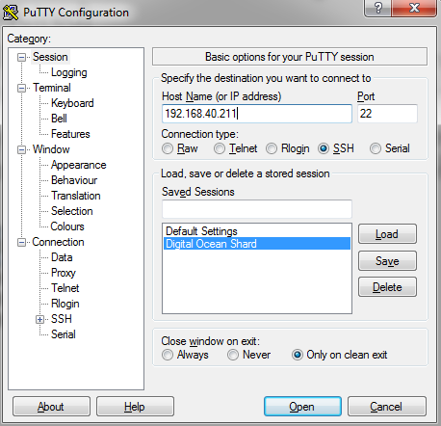
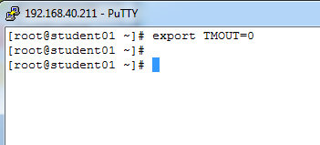
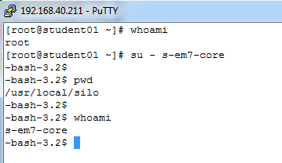
Appliance CLI Access
Use SSH to the ScienceLogic appliance as root (access to port 22 is required). Putty is a common terminal emulator used in Windows. Any Terminal emulator will work if it supports SSH
All of the python (core) processes in EM7 run as s-em7-core, not root. Use “su - s-em7-core” to change to the s-em7-core user
By default EM7 will close the connection after 2 minutes of inactivity. Use export TMOUT=0 stop that behavior.
Platform

Slide 62
Key Directories and Files
Path | Description
/usr/local/silo/proc | Directory of all python backend processes
/usr/local/silo/data/logs | Location of all application logs besides EM7 processes
/data/logs/silo.log | Main EM7 log file and the location of DEBUG output
/var/log | Other log files for applications
/etc/silo.conf | EM7 main configuration file
/etc/my.cnf | MySQL configuration file
/etc/postfix/main.cf | Mail server configuration file
/etc/aliases | Location of inbound email address aliases
Platform

Slide 63
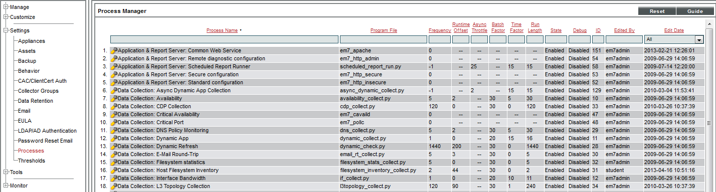
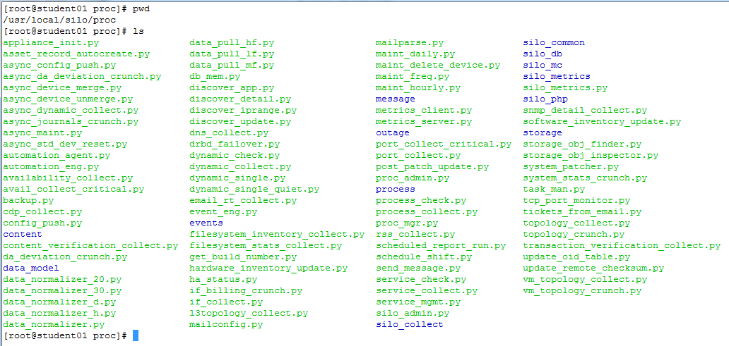
Backend Python processes
/usr/local/silo/proc
The directory contains the EM7 processes. These processes are also found on the page: System > Settings > Processes
These processes are run by
s-em7-core
Platform
Notes:
The home directory for ScienceLogic is usr/local/silo.
The user/local/silo/proc dir contains all the scripts that are being processed in the System > Settings > Processes area.

Slide 64
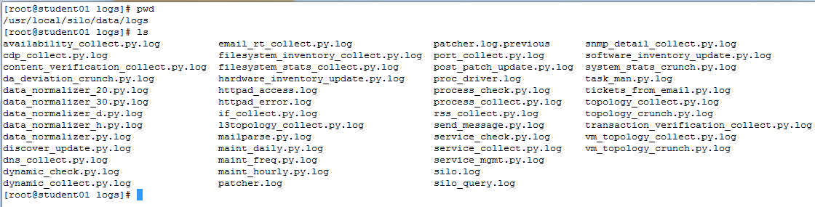
EM7 process log files
usr/local/silo/data/logs
This is the central repository for log files in an EM7 system. The silo.log resides here and is where any process that is in DEBUG will put debug log messages in silo.log.
Platform

Slide 65
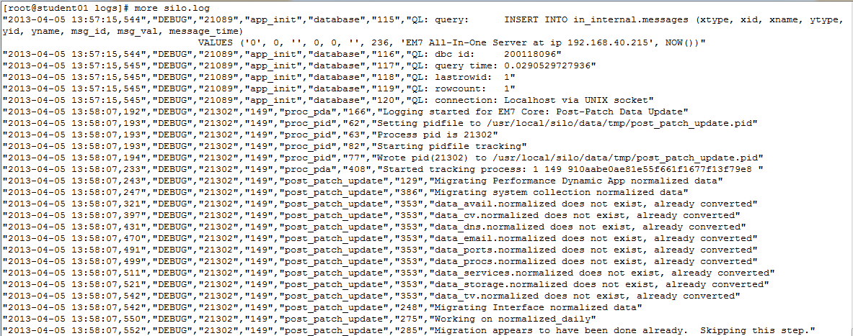
Key log file: silo.log
/data/logs/silo.log
Standard log information on the operation of EM7 is here
If a process is in debug it will provide verbose output to this file
This file (in whole or in part) may need to be downloaded and sent to ScienceLogic Support as part of a troubleshooting effort.
Platform

Slide 66
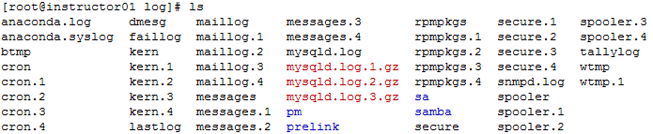
Application log files
/var/log
Log files are found in /var/log (except for silo.log). These include logs for:
cron
mail
mysqld
messages
snmpd
Platform

Slide 67
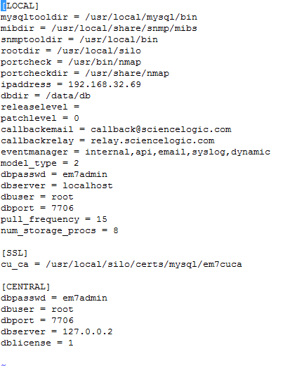
Key configuration file: silo.conf
/etc/silo.conf
Contains configuration information about the appliance itself, such as:
IP address (must match appliances page)
licensing information
directory locations
event parsing
Platform

Slide 68
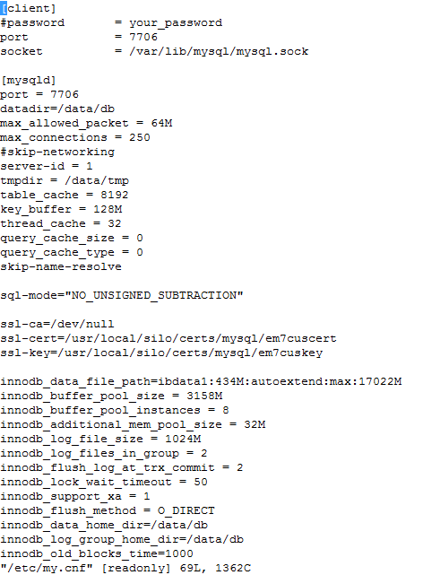
Key configuration file: my.cnf
/etc/my.cnf
MySQL database configuration file
The EM7 build (AO, CU, MC) determines the settings in this file.
Changes should only be made in conjunction with ScienceLogic Support
Platform

Slide 69
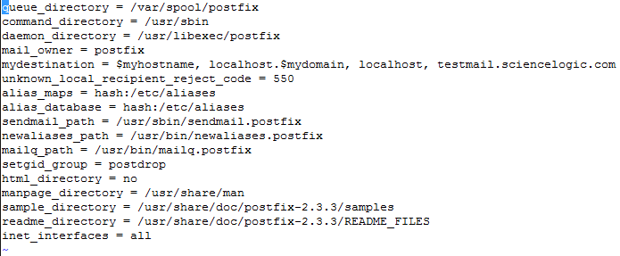
Key configuration file: main.cf
/etc/postfix/main.cf
Mail Server configuration file
Found only on the Database module
When adding any Authorized Email Domains this file will be updated
Platform

Slide 70
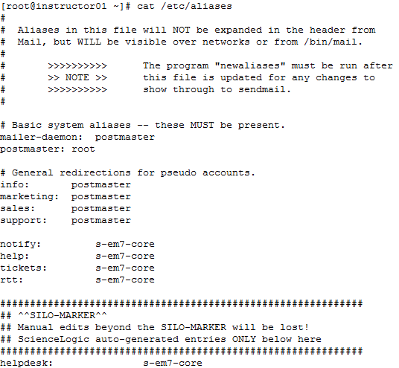
Key configuration file: /etc/aliases
Aliases file:
File is updated when a Tickets from Email policy is created.
The “Destination Email” from the Ticket from Email policy is appended to the aliases file.
We created a policy called “helpdesk” and this entry in the alias file is created.
Platform

Slide 71
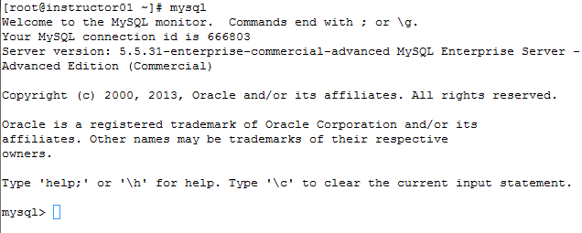
Database Access: CLI
Command Line Interpreter:
log in to the Database server or Data/Mesage Collector server as root
issue the command “mysql”
Platform
Notes:
ScienceLogic automatically creates a default organization, called System. This organization has the ID number “0” (zero). The System organization has some behavior that differs from user-defined organizations.
If you do not specify an organization when creating a user account, the new account is assigned to the System organization.
If you do not specify an organization when performing dynamic-discovery, all devices (and their components), interfaces, and IP networks are assigned to the System organization.
You cannot delete the system organization.
You cannot bulk-edit the system organization.

Slide 72
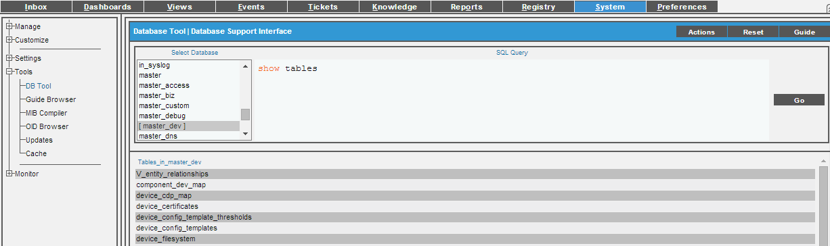
Database Access: DB Tool
DB Tool in the EM7 user interface
System > Tools > DB Tool
This page has full grant rights, restrict access to Admins only!
[Action] button shows various database performance counters
This page is a convenient tool for use when working with ScienceLogic support
Logging: the query and who ran it is in the Audit log
Platform
Notes:
ScienceLogic automatically creates a default organization, called System. This organization has the ID number “0” (zero). The System organization has some behavior that differs from user-defined organizations.
If you do not specify an organization when creating a user account, the new account is assigned to the System organization.
If you do not specify an organization when performing dynamic-discovery, all devices (and their components), interfaces, and IP networks are assigned to the System organization.
You cannot delete the system organization.
You cannot bulk-edit the system organization.

Slide 73
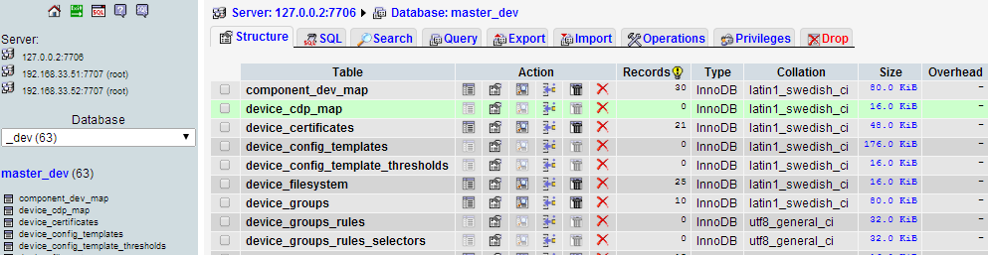
Database access: PHPMyAdmin (PMA)
PHPMyAdmin is a web portal to the MySQL database.
Web browser access: em7_ip:8008
Distributed systems will display a choice as to which database you wish to browse.
PHPMyAdmin access has full rights access
Browse, query, and export data from the EM7 database
CAUTION: never alter tables or import data into the EM7 database
Click here to go to any of the distributed databases
Database list dropdown
List of tables in each database
Platform

Slide 74
Troubleshooting: Debug
The process for enabling debug in an EM7 appliance:
Set the process to Debug on the process page (System > Settings > Processes)
Wait for the process to run on it’s next scheduled run or cause it to run manually
Turn off Debug
Review or Retrieve Log
Turn on Debug
Run Process
Turn Off Debug
Review or Retrieve Log
Platform

Slide 75
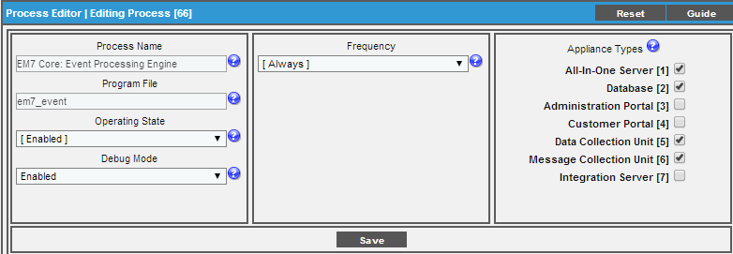

Troubleshooting: Debug
In the User Interface:
System > Settings > Processes, find the process, wrench it set Debug Mode to Enabled. Then [Save]
The next time the process runs the debug output will write to the silo.log
If the process has a Frequency=Always the process will need to be restarted on the CLI in order to pick up the debug flag, i.e. /etc/init.d/em7_event restart
Log into the command line and run the process if needed
System > Settings > Processes, find the process, wrench it set Debug Mode to Enabled. Then [Save]
“Always” frequency processes require a restart in order to turn on the debug function. The best way to do this is to stop the process and then proc_mgr starts it up again.
Turn off Debug by setting the Debug Mode back to “Disabled”. Restart process if necessary.
Platform

Slide 76
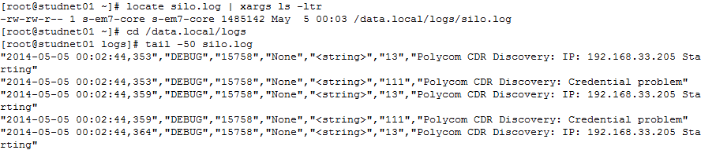
Troubleshooting: Review log file
Review log file:
Navigate to
/data/logs/silo.log
Review using the tail command:
tail –f file.name or just view the last x lines with tail -50 file.name
Platform

Slide 77
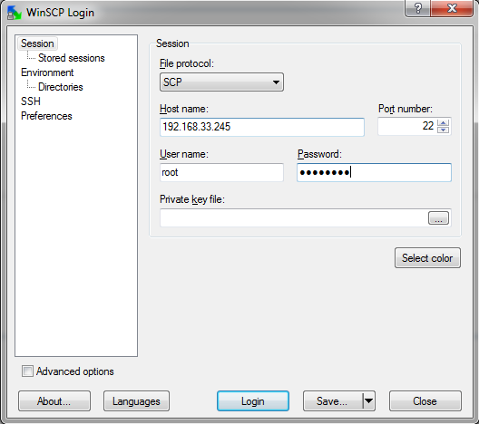
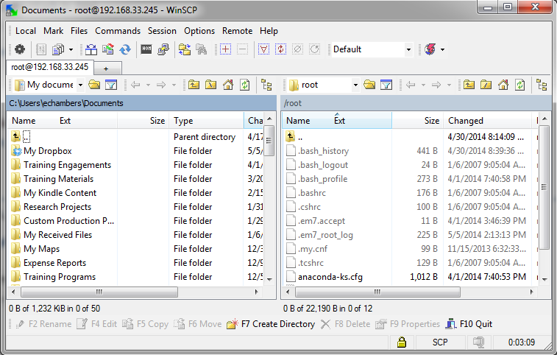
Troubleshooting: Retrieve log file
Retrieve log file:
Log into the target EM7 appliance with WinSCP (Windows Secure Copy). This is a utility that communicates on port 22 (SSH) and features a user interface to make finding and copying files between Windows desktop computers and Linux servers easy. Find info at:
http://winscp.net/eng/download.php
Copy the file to your local system and use any text editor to review it.
Only root is allowed
Platform

Slide 78
Troubleshooting: Common CLI commands
Name | As User | Command | Reason | Comments/Output
SNMPwalk |  | snmpwalk –v2c –c community target_ip oid/mib | Testing that a device is responding to SNMP from a Data Collector | Helps to define…
EM7 status check |  | /etc/init.d/em7 status | Determine if EM7 is running | EM7: is running
Restart a daemon process |  | /etc/init.d/process_name restart/stop/start |  | Confirmation of status
Run a process manually | s-em7-core | /usr/local/silo/proc/process_name | Manually run a process outside of it’s normal window | CLI will return to prompt when complete
Check if port is open from database to Data/Message Collector | root | nmap –p 7707 data/message_collector_ip | Confirm that required network path is working to new or existing collector | List of open ports on the target device
Web site check | root | curl target_website_url | Confirm that the collector can reach the target web site | The source text of the target website.
Review a log file in real time | root | tail –f number (number is the number of lines to scroll) | Allows the user to see new lines as they are written to a log file | Streaming log text on the console
Platform

Slide 79
Resources and Questions
For more information:
System Administration Manual
Guide Button
All manuals are available on the Customer Portal:
http://portal.sciencelogic.com
Platform

Slide 80

Ron Burch
rburch@sciencelogic.com

